Slide 1
307401
Big Data and Data Warehouses
Introduction to Big Data

Slide 2
Introduction to Big Data

Slide 3
Content
Welcome to the world of Big Data!
Understanding Big Data: Definition and significance.
Exploring the 5 V’s of Big Data: Volume, Velocity, Variety, Veracity, and Value.

Slide 4
Big Data in a Nutshell
The evolution of technology over the past few decades has dramatically transformed the way we generate, store,
and process data.
In the early days of computing, data was limited to what could be managed by traditional relational databases. However, the advent of the internet in the 1990s led to an exponential increase in data production, fueled by the rise of e-commerce, social media, and the digitization of countless industries.
As more devices connected to the internet, including smartphones, sensors, and IoT devices, the volume of data surged to unprecedented levels.
This data explosion highlighted the limitations of traditional data management and processing tools, necessitating the development of new technologies capable of handling the scale and complexity of modern data.
To address these challenges, the early 2000s saw the introduction of groundbreaking technologies like Google File System (GFS) and MapReduce, which laid the foundation for scalable data storage and parallel processing.
These innovations led to the creation of Apache Hadoop, an open-source framework that brought the power of
GFS and MapReduce to the wider community.
Alongside Hadoop, a variety of new tools and frameworks emerged, such as Apache Spark for in-memory processing, Apache Kafka for real-time data streaming, and NoSQL databases like MongoDB and Cassandra for flexible, schema-less data storage.
These technologies have collectively formed the backbone of the Big Data ecosystem, enabling organizations to efficiently process and analyze vast datasets, uncover insights, and drive data-driven decision-making in ways that were previously unimaginable.

Slide 5
راصتخاب ،ةمخضلا تانايبلا
.اهجلاعنو ،اهنزخنو ،تانايبلا اهب جتنن يتلا ةقيرطلا يف يرذج رييغت ىلإ ةيضاملا ةليلقلا دوقعلا ىدم ىلع ايجولونكتلا روطت ىدأ •
.ةيديلقتلا ةيقئلاعلا تانايبلا دعاوق ةطساوب هترادإ نكمي ام ىلع ةرصتقم تانايبلا تناك ،ةبسوحلل ىلولأا مايلأا يف •
لئاسوو ،ةينورتكللإا ةراجتلا مادختسا دايدزا كلذ اذغو ،تانايبلا جاتنإ يف ةلئاه ةدايز ىلإ ىدأ تاينيعستلا يف تنرتنلإا روهظ نا لاا •
.تاعانصلاو تامدخلا نم ىصحي لا ددع ةنمقرو ،يعامتجلاا لصاوتلا
مجح عفترا ،ءايشلأا تنرتنإ ةزهجأو راعشتسلاا ةزهجأو ةيكذلا فتاوهلا كلذ يف امب ،تنرتنلإاب ةلصتملا ةزهجلأا ددع ديازت عمو •
.ةقوبسم ريغ تايوتسم ىلإ تانايبلا
ريوطت مزلتسا امم ،اهتجلاعمو تانايبلا ةرادإ يف ةمدختسملا ةيديلقتلا تاودلأا ىلع ءوضلا تانايبلا مجح يف ريبكلا دايدزلاا اذه طلس •
.اهديقعتو ةثيدحلا تانايبلا مجح عم لماعتلا ىلع ةرداق ةديدج تاينقت
Google (GFS) تافلم ماظن لثم ةدئار تاينقت لاخدإ نيرشعلاو يداحلا نرقلا نم لولأا دقعلا لئاوأ دهش ،تايدحتلا هذه ةهجاوملو •
.ةيزاوتملا ةجلاعمللو عسوتلل ةلباقلا تانايبلا نيزختل ساسلأا تسرأ يتلاو ،MapReduceو
GFS ـلا ةوق بلج ردصملا حوتفم لمع راطإ نع ةرابع يهو ،Apache Hadoop ةموظنم ءاشنإ ىلإ تاراكتبلاا هذه تدأ •
.عسولأا عمتجملا ىلإ MapReduce و
عيرس لكشب تانايبلا ةجلاعمل Apache Spark لثم ،ةديدجلا رطلأاو تاودلأا نم ةعونتم ةعومجم ترهظ ،Hadoop بناج ىلإ •
لثم NoSQL تانايب دعاوقو ،يلعفلا تقولا يف تانايبلا قفدت ةرادلإ Apache Kafka و ،ةزهجلأل ةيسيئرلا ةركاذلا لخاد
.ةددحملا لكايهلا نودب ةنرملا تانايبلا مدختست يتلاو Cassandra و MongoDB
تانايبلا تاعومجم ةجلاعم نم تاسسؤملا نكم امم ،ةمخضلا تانايبلل يئيبلا ماظنلل يرقفلا دومعلا ةعمتجم تاينقتلا هذه تلكش دقل •
نكي مل قرطب تانايبلا ىلإ ةدنتسملا رارقلا عنص ةيلمع عفدو ،تانايبلا لخاد ةيفخلا تامولعملا نع فشكلاو ،ةءافكب اهليلحتو ةمخضلا
.قباسلا يف اهروصت نكمملا نم

Slide 6

Apache Foundation
The Apache Software Foundation (ASF) is a non-profit organization established in 1999 to support a variety of open-source software projects. Known for overseeing well-known projects such as the Apache HTTP Server and Apache Hadoop, the ASF provides resources, infrastructure, and a collaborative framework for open-source development, fostering innovation and community-driven progress.
The Apache License 2.0 is a permissive open-source license that allows for free redistribution, modification, and use of software, both commercially and privately. It includes provisions for a patent grant, ensuring contributors cannot sue users for patent infringement, and requires that modifications be documented and the original license included in distributions. This license is favored for its flexibility and minimal restrictions, making it a popular choice for many open-source projects.
عيراشم نم ةعونتم ةعومجم معدل 1999 ماع يف تسسأت ةيحبر ريغ ةمظنم يه Apache Software Foundation (ASF) •
،Apache Hadoop و Apache HTTP مداخ لثم ةزراب عيراشم ىلع فارشلإاب ةسسؤملا رهتشت .ردصملا ةحوتفم تايجمربلا
ىلع مئاقلا مدقتلاو راكتبلاا ززعي امم ،ردصملا ةحوتفم تايجمربلا ريوطتل ينواعتلا لمعلا راطإو ةيتحتلا ةينبلاو دراوملا رفوتو
.عمتجملا
،تايجمربلل رحلا مادختسلااو ليدعتلاو عيزوتلا ةداعإب حمست ةنرم ردصملا ةحوتفم ةصخر Apache 2.0 تايجمرب ةصخر لثمت •
.ةصاخلا ضارغلأل وأ ةيراجت ضارغلأ ءاوس
،عارتخلاا تاءارب كاهتنا ةمهتب نيمدختسملل نيمهاسملا ةاضاقم مدع نمضي امم ،عارتخلاا تاءارب حنمل امً اكحأ ةصخرلا نمضتت •
.تاعيزوتلا يف ةيلصلأا ةصخرلا جاردإو تلايدعتلا قيثوت بلطتتو
ةحوتفم تايجمربلا عيراشم نم ديدعلل ًلاضفم ارً ايخ اهلعجي امم ،ةليلقلا اهدويقو اهتنورم لضفب ةريبك ةيبعشب ةصخرلا هذه ىظحت •
.ردصملا

Slide 7
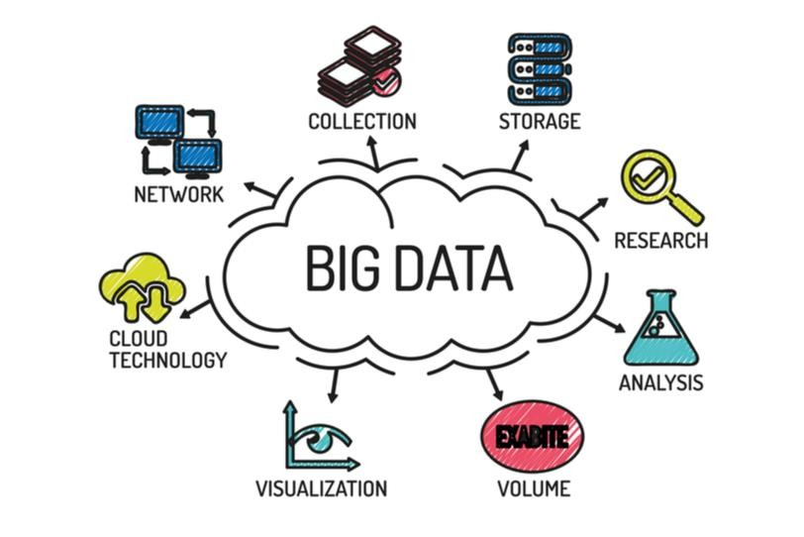
What is Big Data?
Big Data refers to datasets that are so large or complex that
traditional data processing applications are inadequate.
It is not a single technique or a tool, rather it has become a complete subject, which involves various tools, techniques and frameworks.
Big Data requires advanced technologies to efficiently process
and analyze.
Big Data enables organizations to gain insights and make data- driven decisions.

Slide 8






Evolution of Big Data
The Model of Generating/Consuming Data has Changed
Old Model: Few companies are generating data, all others are consuming data
New Model: all of us are generating data, and all of us are consuming data

Slide 9



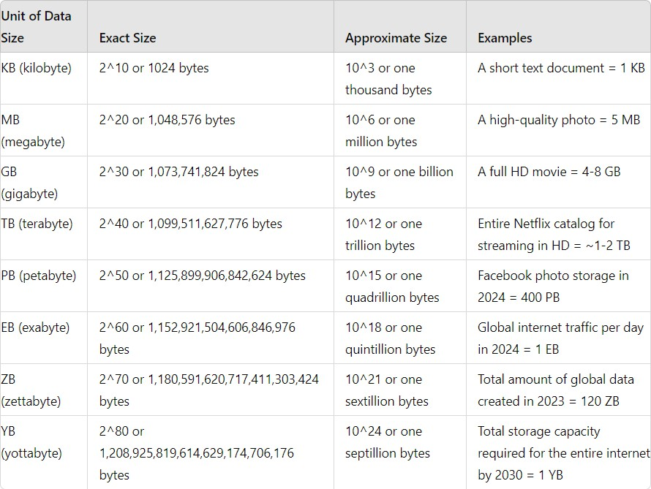
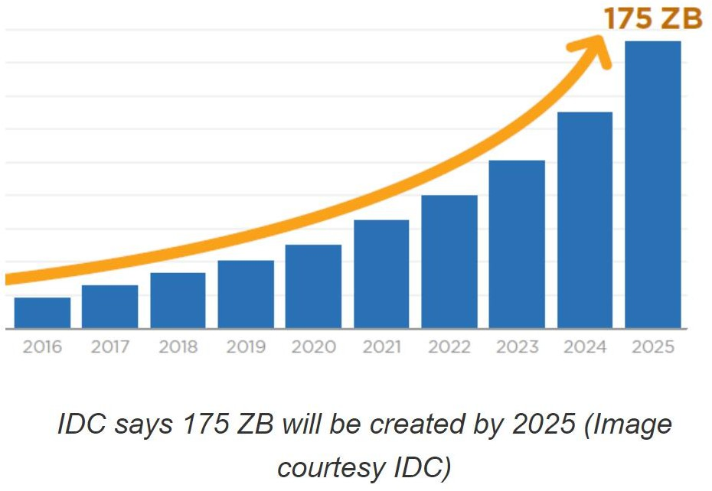
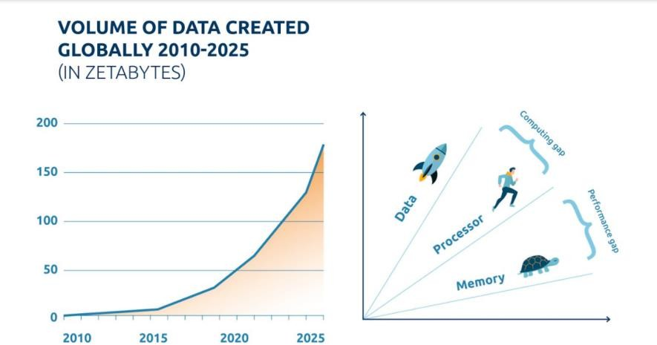
Data Sizes and Data Units

Slide 10
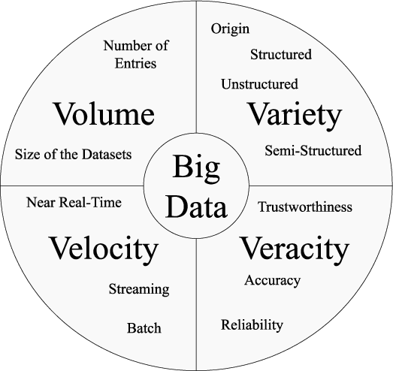
Characteristics of Big Data
Volume: The sheer size of data generated every second.
Velocity: The speed at which new data is generated and processed.
Variety: The different types of data.
Veracity: The accuracy and trustworthiness of the data.
Value: The potential insights and benefits that can be derived from data.

Slide 11
Volume
Definition: Refers to the massive amount of data generated.
Examples:
Social media posts, transaction records, sensor data.
Facebook generates approximately 4 petabytes of data per day.
Walmart handles over 1 million customer transactions every hour.
Implications:
Requires scalable storage solutions.
Necessitates advanced processing techniques to manage and analyze data efficiently.

Slide 12
Velocity
Definition: The speed at which data is generated and processed.
Examples:
Real-time data streams from Social Media, IoT devices, financial market data.
Twitter processes around 500 million tweets per day.
High-frequency trading algorithms in stock markets operate in milliseconds.
Implications:
Real-time data processing capabilities.
Need for technologies like Apache Kafka and Spark Streaming.

Slide 13
Variety
Definition: The different types of data.
Examples:
Structured: Relational databases, spreadsheets.
Semi-structured: XML, JSON.
Unstructured: Text documents, social media posts, multimedia files.
Implications:
Diverse data integration methods.
Techniques for processing and analyzing different data formats.

Slide 14
Veracity – تانايبلا ةيقوثوم – تانايبلا ةقد
Definition: The accuracy and reliability of data.
Examples:
Incomplete data entries.
Data from biased sources.
Implications:
Data cleaning and validation processes.
Importance of data governance and quality management.

Slide 15
Value
Definition: The potential benefits derived from analyzing data.
Importance: Turning data into actionable insights to drive business decisions.
Examples:
Improved decision-making through data insights.
Enhanced customer experiences and personalization.
Implications:
Focus on extracting meaningful insights.
Leveraging data to drive business strategy and innovation.

Slide 16
Questions?
Can you think of examples of Big Data you encounter in daily life?

Slide 17
Historical Context
Evolution of Data Processing and Storage

Slide 18
Content
Introduction to the evolution of data processing and storage.
Overview of key milestones and technological advancements.
Understanding how these changes impact current Big Data practices.

Slide 19


Early Data Processing (1950s - 1960s)
Mainframe Computers: The advent of mainframe computers
for batch processing.
Examples:
IBM 701, UNIVAC.
Punch Cards: Used for data input and storage.
Limitations: Limited storage capacity, slow processing speeds.
Key Technologies:
Magnetic tapes for data storage.
Assembly language for programming.

Slide 20
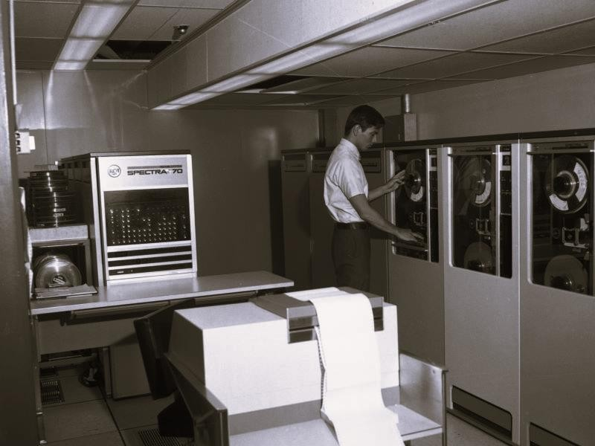
The Rise of Databases (1970s - 1980s)
Relational Databases: Introduction of relational
database management systems (RDBMS).
Key Innovators: Edgar F. Codd, IBM System R.
SQL: Development of Structured Query Language (SQL) for data manipulation.
Data Storage Advancements:
Hard disk drives (HDD) replacing magnetic tapes.
Increased storage capacity and faster data retrieval.

Slide 21
Data Warehousing (1990s)
Data Warehousing Concept: Centralized repositories for integrating data from multiple sources.
Purpose: Analytical reporting and data analysis.
Key Innovations:
ETL (Extract, Transform, Load) processes for data integration.
OLAP (Online Analytical Processing) for complex queries.
Notable Technologies:
Teradata, Oracle Data Warehouse.

Slide 22
Emergence of Big Data (2000s)
Internet Explosion: Rapid growth of the internet, leading to massive data generation.
Examples: Social media, e-commerce, IoT devices.
Challenges: Traditional RDBMS struggled with the volume, velocity, and variety of data.
NoSQL Databases: Development of NoSQL databases to handle unstructured data.
Examples: MongoDB, Cassandra, HBase.

Slide 23
Hadoop and the Big Data Era (2006 - Present)
Apache Hadoop: Open-source framework for distributed storage and processing.
Components: HDFS (Hadoop Distributed File System), MapReduce.
Big Data Ecosystem: Growth of complementary technologies.
Examples: Apache Spark, Kafka, Flink...etc.
Cloud Computing: Emergence of cloud platforms for scalable storage and processing.
Providers: Amazon Web Services (AWS), Google Cloud, Microsoft Azure.

Slide 24
Modern Data Processing and Storage
Real-Time Data Processing: Technologies for real-time data ingestion and analysis.
Examples: Apache Storm, Spark Streaming.
Data Lakes: Centralized repositories for storing all types of data in their native format.
Benefits: Scalability, flexibility, and cost effectiveness.
Machine Learning Integration: Use of Big Data for training machine learning models.
Frameworks: TensorFlow, PyTorch.

Slide 25
Importance and Applications of Big Data

Slide 26
Content
Introduction to the significance of Big Data in modern industries.
Overview of key benefits and applications.
Exploring use cases in various sectors: finance, healthcare, retail, and more.

Slide 27
Importance of Big Data
Data-Driven Decision Making: Enables organizations to make informed decisions based on data
insights.
Competitive Advantage: Helps companies gain a competitive edge by understanding market trends and customer behavior.
Innovation: Drives innovation through the discovery of new patterns and opportunities.
Operational Efficiency: Enhances operational processes by identifying inefficiencies and optimizing resources.
Personalization: Allows for personalized customer experiences by analyzing individual preferences and behaviors.

Slide 28

Big Data in Finance
Fraud Detection:
Example: JPMorgan Chase uses big data to detect fraud, saving the company millions of dollars annually.
Data Volume: JPMorgan Chase processes over 20 billion transactions annually.
Data Velocity: These transactions generate data in real-time, requiring instant analysis to detect potential fraud.
Conventional Limitation: Traditional rule-based systems cannot keep up with the real- time processing and adaptive learning needed to detect sophisticated fraud patterns.
Transactions per second: Over 635 transactions per second on average.
Data Processing: Requires machine learning models capable of real-time detection and adaptation.
Risk Management:
Example: Morgan Stanley uses big data to manage risk in real-time, reducing potential losses.
Data Volume: Morgan Stanley handles data from millions of trades daily, market feeds, and external economic indicators.
Data Velocity: Market conditions can change within milliseconds, necessitating immediate analysis and response.
Conventional Limitation: Traditional risk management systems cannot process and analyze this volume and velocity of data fast enough to provide timely insights and mitigation strategies.
Trades per second: Thousands of trades per second during peak times.
Data Streams: Continuous data streams from market feeds, requiring real-time analytics and decision-making.

Slide 29
Big Data in Finance
Customer Analytics:
Example: Bank of America uses big data to offer personalized financial advice through its virtual assistant, Erica.
Data Volume: Bank of America serves over 66 million customers, generating terabytes of data from transactions, online interactions, and service requests.
Data Variety: Data comes in various forms, including structured transaction data, unstructured customer service interactions, and semi- structured online behavior.
Conventional Limitation: Traditional data analytics tools struggle with integrating and analyzing such diverse data types to generate real- time, personalized insights.
Data Sources: Integrates data from mobile apps, ATMs, branch interactions, and online services.
Personalization: Uses advanced analytics to tailor services to individual customer needs in real-time.
Algorithmic Trading:
Example: Goldman Sachs uses big data analytics to make split-second trading decisions, handling billions in trades daily.
Data Volume: Goldman Sachs processes petabytes of market data daily, including stock prices, trading volumes, and economic indicators.
Data Velocity: High-frequency trading algorithms operate in microseconds, executing thousands of trades per second.
Conventional Limitation: Traditional trading systems cannot handle the required speed and complexity of data processing needed for high- frequency trading.
Trades per second: Tens of thousands of trades per second.
Market Data: Analyzes market data in microseconds to make split-second trading decisions.

Slide 30

Big Data in Healthcare
Predictive Analytics:
Example: Kaiser Permanente uses predictive analytics to reduce hospital readmissions, saving over $1 billion annually.
Data Volume: Kaiser Permanente collects data from millions of patient interactions each year, including electronic health records (EHRs), lab results, and imaging data.
Data Velocity: Real-time data analysis is required to monitor patient conditions and predict potential readmissions.
Conventional Limitation: Traditional methods cannot process the sheer volume of diverse health data in
real-time to predict outcomes effectively.
Patient Records Analyzed: Millions annually
Outcome: Significant reduction in readmissions and over $1 billion saved annually.
Personalized Medicine:
Example: The Cleveland Clinic uses big data to provide personalized treatment plans for cancer patients, improving survival rates.
Data Volume: The Cleveland Clinic analyzes genomic data, medical histories, and treatment outcomes from tens of thousands of cancer patients.
Data Variety: Data includes structured medical records, unstructured clinical notes, and genetic sequences.
Conventional Limitation: Conventional approaches struggle to integrate and analyze such diverse and complex datasets to tailor individualized treatment plans.
Genomic Data: Tens of thousands of genetic sequences analyzed
Outcome: Improved survival rates for cancer patients through tailored treatments.

Slide 31
Big Data in Healthcare
Operational Efficiency:
Example: Mount Sinai Medical Center uses big data to predict patient admissions and optimize staff scheduling, reducing wait times by 10%.
Data Volume: Mount Sinai processes data from thousands of patient admissions, discharges, and transfers daily.
Data Velocity: Predictive models need to be updated in real-time to adjust staffing and resource allocation dynamically.
Conventional Limitation: Traditional scheduling systems cannot adapt quickly enough to real-time data, leading to inefficiencies and longer wait times.
Admissions Processed Daily: Thousands
Outcome: 10% reduction in patient wait times.
Medical Research:
Example: Pfizer uses big data to streamline clinical trials, reducing development time for new drugs.
Data Volume: Pfizer handles data from millions of patients across multiple clinical trials, including genetic information, trial
results, and patient feedback.
Data Variety: Data includes structured trial data, unstructured patient reports, and semi-structured genetic data.
Conventional Limitation: Traditional research methods cannot manage and analyze the vast amount of diverse data efficiently, slowing down the drug discovery process.
Clinical Trial Data: Millions of patient data points analyzed
Outcome: Faster drug development and streamlined clinical trials.

Slide 32

Big Data in Retail
Customer Insights:
Example: Amazon uses big data to recommend products, contributing to 35% of its annual sales.
Data Volume: Amazon processes petabytes of data daily from millions of customer interactions, including browsing history, purchase records, and product reviews.
Data Variety: Data includes structured transaction data, unstructured customer reviews, and semi-structured browsing behavior.
Conventional Limitation: Traditional methods cannot integrate and analyze such diverse
data in real-time to provide personalized recommendations effectively.
Customer Interactions: Millions daily
Outcome: Personalized recommendations contribute to 35% of annual sales.
Inventory Management:
Example: Walmart uses big data analytics to manage its supply chain, reducing stockouts by 16%.
Data Volume: Walmart processes data from over 11,500 stores in 27 countries, including sales data, inventory levels, and supplier
information.
Data Velocity: Real-time data analysis is required to monitor inventory levels and manage supply chain logistics.
Conventional Limitation: Traditional inventory management systems cannot process the volume and velocity of data needed to optimize supply chain processes in real-time.
Stores Data Processed: Over 11,500 stores globally
Outcome: 16% reduction in stockouts through optimized supply chain management.

Slide 33
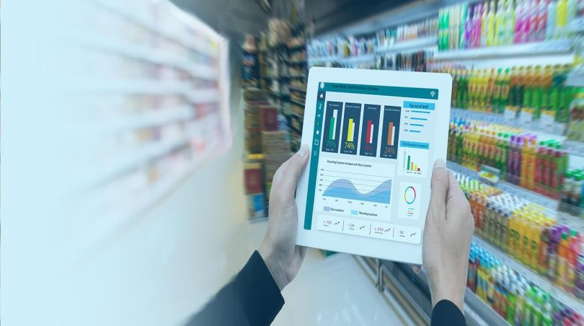
Big Data in Retail
Pricing Strategies:
Example: Macy’s uses big data to implement dynamic pricing, increasing revenue by 10%.
Data Volume: Macy’s analyzes data from millions of transactions, competitor pricing, and market demand trends.
Data Variety: Data includes structured sales data, unstructured competitor pricing information, and semi-structured market trends.
Conventional Limitation: Traditional pricing strategies cannot adapt quickly enough to market
changes and competitor pricing, leading to missed revenue opportunities.
Transactions Analyzed: Millions
Outcome: 10% increase in revenue through dynamic pricing models.
Sentiment Analysis:
Example: Nike uses sentiment analysis to track brand perception and inform marketing strategies, leading to a 15% increase in customer satisfaction.
Data Volume: Nike analyzes data from millions of social media posts, customer reviews, and feedback forms.
Data Velocity: Real-time monitoring of social media and customer feedback is required to gauge brand sentiment.
Data Variety: Data includes unstructured social media posts, structured customer reviews, and semi-structured feedback forms.
Conventional Limitation: Traditional methods cannot process and analyze large volumes of unstructured data to provide timely insights into
brand perception.
Social Media Posts Monitored: Millions
Outcome: 15% increase in customer satisfaction by tracking and responding to brand sentiment.

Slide 34

Big Data in Manufacturing
Quality Control:
Example: Toyota uses big data to improve quality control, reducing defects by 30%.
Data Volume: Toyota analyzes millions of data points from its production lines, including sensor data, inspection reports, and operational logs.
Data Velocity: Real-time monitoring of production processes is required to detect and address quality issues promptly.
Conventional Limitation: Traditional quality control methods cannot process the
volume and speed of data necessary to identify and rectify defects in real-time.
Outcome: 30% reduction in product defects through improved quality control.
Predictive Maintenance:
Example: General Electric uses predictive maintenance to reduce equipment downtime by 20%.
Data Volume: General Electric collects terabytes of data from sensors embedded in industrial equipment, capturing operational parameters, usage patterns, and environmental conditions.
Data Velocity: Real-time data streams from thousands of sensors require immediate analysis to predict and prevent equipment failures.
Conventional Limitation: Traditional maintenance schedules cannot adapt quickly to real-time data, leading to unexpected downtimes and higher maintenance costs.
Outcome: 20% reduction in equipment downtime through predictive maintenance.

Slide 35
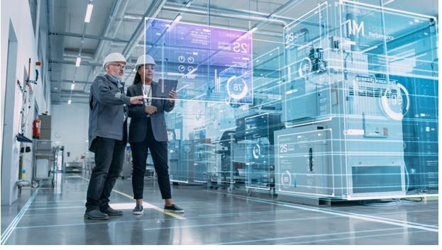
Big Data in Manufacturing
Supply Chain Optimization:
Example: Procter & Gamble uses big data to optimize its supply chain, saving $1 billion annually.
Data Volume: Procter & Gamble processes data from thousands of suppliers, logistics providers, and retail partners globally.
Data Velocity: Real-time data analysis is essential to manage inventory levels, transportation logistics, and supplier performance.
Conventional Limitation: Traditional supply chain management systems cannot handle the complexity and speed required for optimal supply chain operations.
Outcome: $1 billion annual savings through optimized supply chain management.
Product Innovation:
Example: 3M uses big data to accelerate product development, launching new products 20% faster.
Data Volume: 3M collects and analyzes vast amounts of data from market research, customer feedback, and R&D activities.
Data Variety: Data includes structured market analysis reports, unstructured customer reviews, and semi-structured experimental results.
Conventional Limitation: Traditional product development cycles cannot leverage diverse and extensive data sources
efficiently to accelerate innovation.
Outcome: 20% faster product launches through accelerated product development.

Slide 36

Big Data in Transportation
Traffic Management:
Example: The city of Los Angeles uses big data to optimize traffic light timing, reducing congestion by 10%.
Data Volume: Los Angeles collects data from thousands of sensors and cameras across the city, monitoring traffic flow, vehicle speeds, and congestion levels.
Data Velocity: Real-time data processing is required to adjust traffic light
timings dynamically.
Conventional Limitation: Traditional traffic management systems cannot process and analyze real-time data effectively to optimize traffic light timings.
Outcome: 10% reduction in traffic congestion through optimized traffic light timing.
Fleet Management:
Example: UPS uses big data to optimize delivery routes, saving 10 million gallons of fuel annually.
Data Volume: UPS processes data from millions of deliveries, including vehicle locations, delivery times, and traffic conditions.
Data Velocity: Real-time route optimization is necessary to adjust to changing traffic conditions and delivery demands.
Conventional Limitation: Traditional route planning systems cannot adapt quickly to real-time data, leading to inefficiencies and higher fuel consumption.
Outcome: 10 million gallons of fuel saved annually through optimized delivery routes.

Slide 37
Big Data in Transportation
Predictive Maintenance:
Example: Delta Airlines uses predictive maintenance to reduce flight delays due to mechanical issues by 15%.
Data Volume: Delta Airlines collects terabytes of data from aircraft sensors, including engine performance, fuel usage, and mechanical health.
Data Velocity: Real-time data analysis is required to predict and prevent mechanical issues before they cause delays.
Conventional Limitation: Traditional maintenance schedules cannot adapt quickly to real-time data, leading to
unexpected breakdowns and delays.
Outcome: 15% reduction in flight delays due to mechanical issues through predictive maintenance.
Public Transportation:
Example: Transport for London uses big data to improve bus schedules and reduce waiting times by 12%.
Data Volume: Transport for London processes data from millions of passenger journeys, bus locations, and
timetable adherence.
Data Velocity: Real-time data analysis is required to adjust bus schedules dynamically based on passenger demand and traffic conditions.
Conventional Limitation: Traditional public transportation systems cannot process and analyze real-time data effectively to optimize schedules and reduce waiting times.
Outcome: 12% reduction in waiting times through improved bus schedules.

Slide 38

Big Data in Energy
Smart Grids:
Example: Duke Energy uses big data to manage its smart grid, reducing outages by 25%.
Data Volume: Duke Energy processes data from millions of smart meters, sensors, and grid equipment, capturing energy usage, grid status, and environmental conditions.
Data Velocity: Real-time data analysis is required to monitor grid performance and detect potential issues before they lead to outages.
Conventional Limitation: Traditional grid management systems cannot process and analyze the volume and speed of data necessary to optimize grid operations and reduce outages.
Outcome: 25% reduction in outages through improved smart grid management.
Renewable Energy:
Example: Google uses big data to optimize its renewable energy projects, achieving 100% renewable energy for its operations.
Data Volume: Google collects data from solar panels, wind turbines, and other renewable energy sources, monitoring energy production and consumption in real-time.
Data Variety: Data includes structured energy production data, unstructured weather forecasts, and semi-structured maintenance logs.
Conventional Limitation: Traditional energy management systems cannot integrate and analyze diverse data sources
effectively to optimize renewable energy usage.
Outcome: Achieved 100% renewable energy for operations through optimized management of renewable energy projects.

Slide 39
Big Data in Energy
Energy Efficiency:
Example: Siemens uses big data to improve building energy management, reducing energy consumption by 20%.
Data Volume: Siemens analyzes data from building sensors, HVAC systems, and energy usage records to identify inefficiencies and optimize energy consumption.
Data Velocity: Real-time monitoring and analysis are required to adjust building systems dynamically for optimal energy efficiency.
Conventional Limitation: Traditional building management systems cannot process and analyze the volume and
variety of data required to achieve significant energy savings.
Outcome: 20% reduction in energy consumption through improved building energy management.
Asset Management:
Example: Shell uses big data to monitor and maintain its oil rigs, reducing maintenance costs by 10%.
Data Volume: Shell collects terabytes of data from sensors on oil rigs, monitoring equipment performance,
environmental conditions, and operational status.
Data Velocity: Real-time data analysis is essential to predict maintenance needs and prevent equipment failures.
Conventional Limitation: Traditional asset management systems cannot handle the volume and speed of data required to optimize maintenance schedules and reduce costs.
Outcome: 10% reduction in maintenance costs through optimized asset management.

